Slide 1
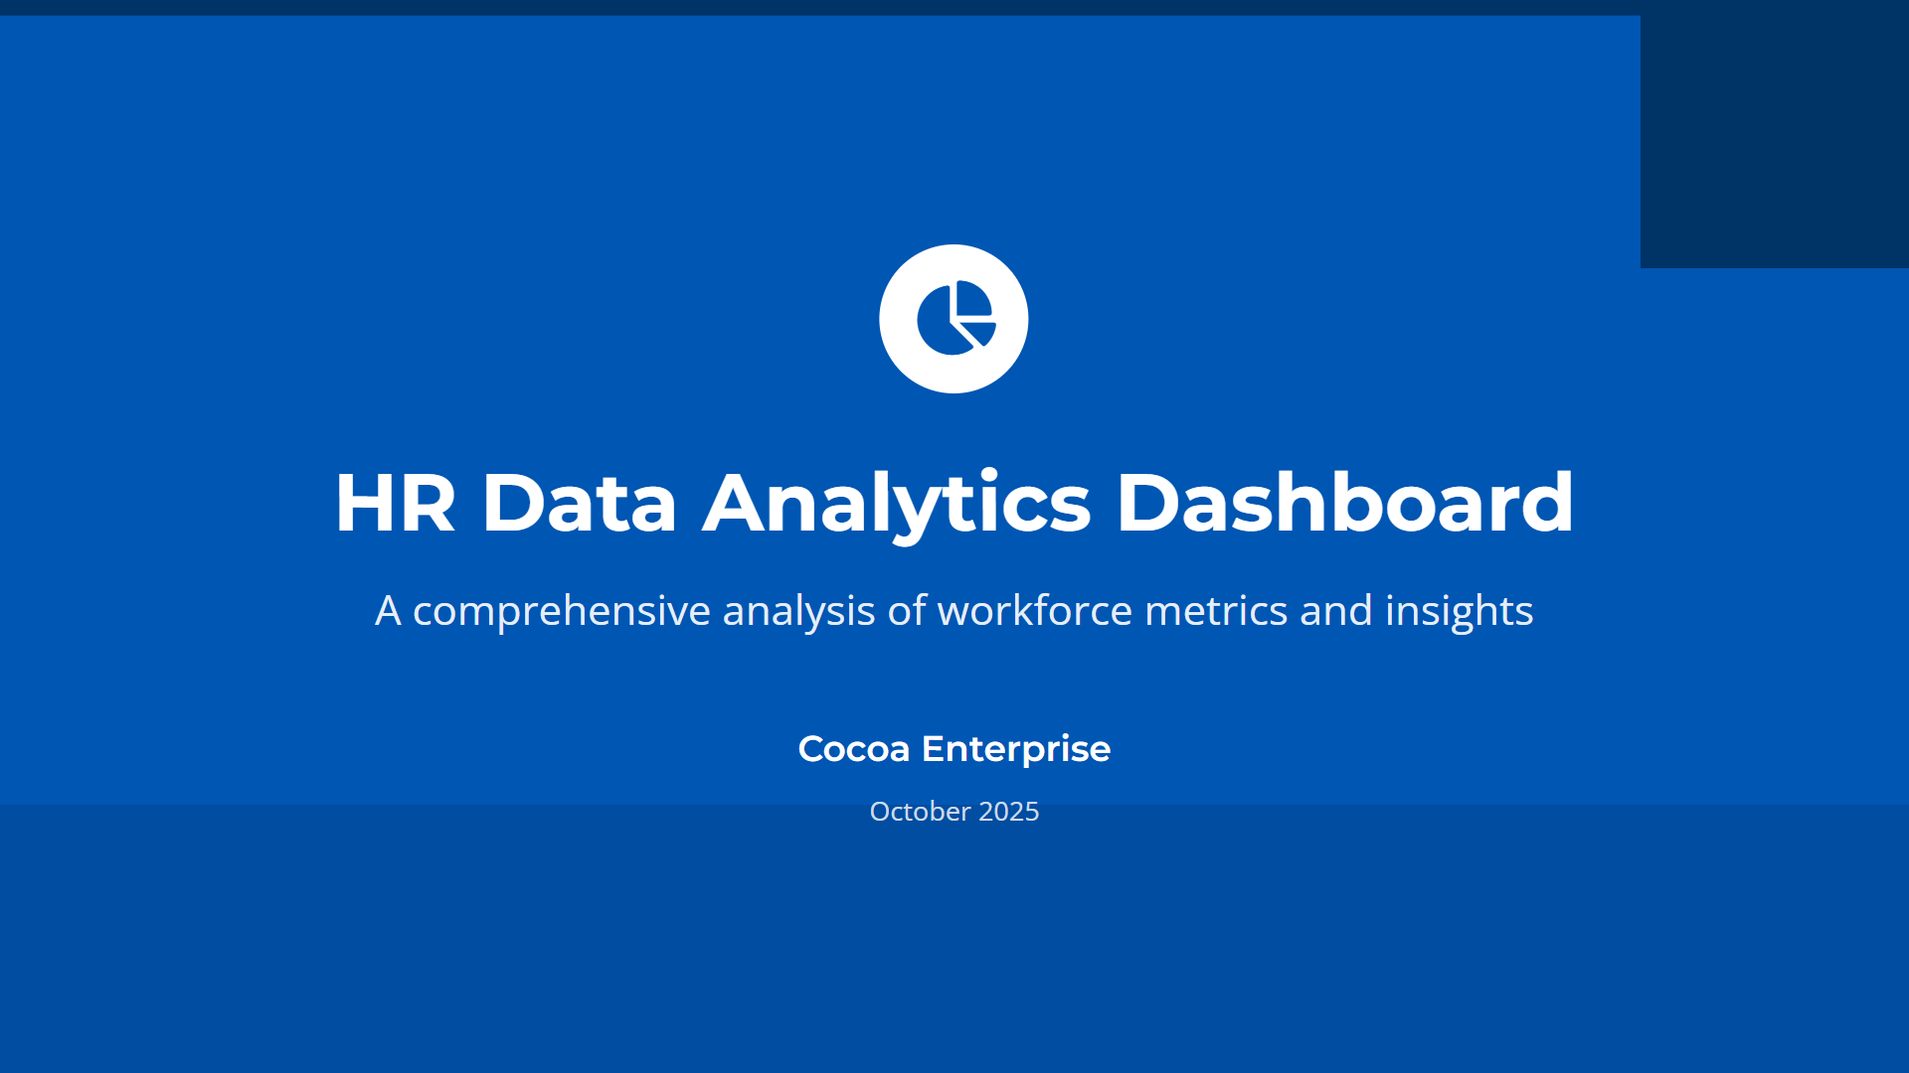

Slide 2
Essential Metrics Framework The project covers four critical metric categories:
Workforce Composition- Headcount analysis, demographics, organizational structure
Performance & Productivity- Employee engagement scores, performance ratings, productivity indicators
Talent Management- Recruitment metrics, turnover analysis, retention patterns
Compensation Analysis- Pay equity, benefits utilization, total rewards distribution
Analytical Capabilities:
The framework outlines three levels of analytics:
Descriptive Analytics- Historical reporting and trend analysis
Predictive Analytics - Turnover prediction and hiring forecasting
Prescriptive Analytics - Recommendation systems and optimization models

Slide 3
Strategic Applications
Key business applications include:
Workforce Planning - Succession planning and skills gap analysis
DEI Initiatives - Diversity tracking and pay equity analysis
Employee Experience - Journey mapping and engagement optimization
Implementation Framework
Critical success factors covering:
Data Quality Management - Governance, privacy, and validation
Stakeholder Alignment - Executive buy-in and user training
Continuous Improvement - Feedback loops and metric evolution

Slide 4
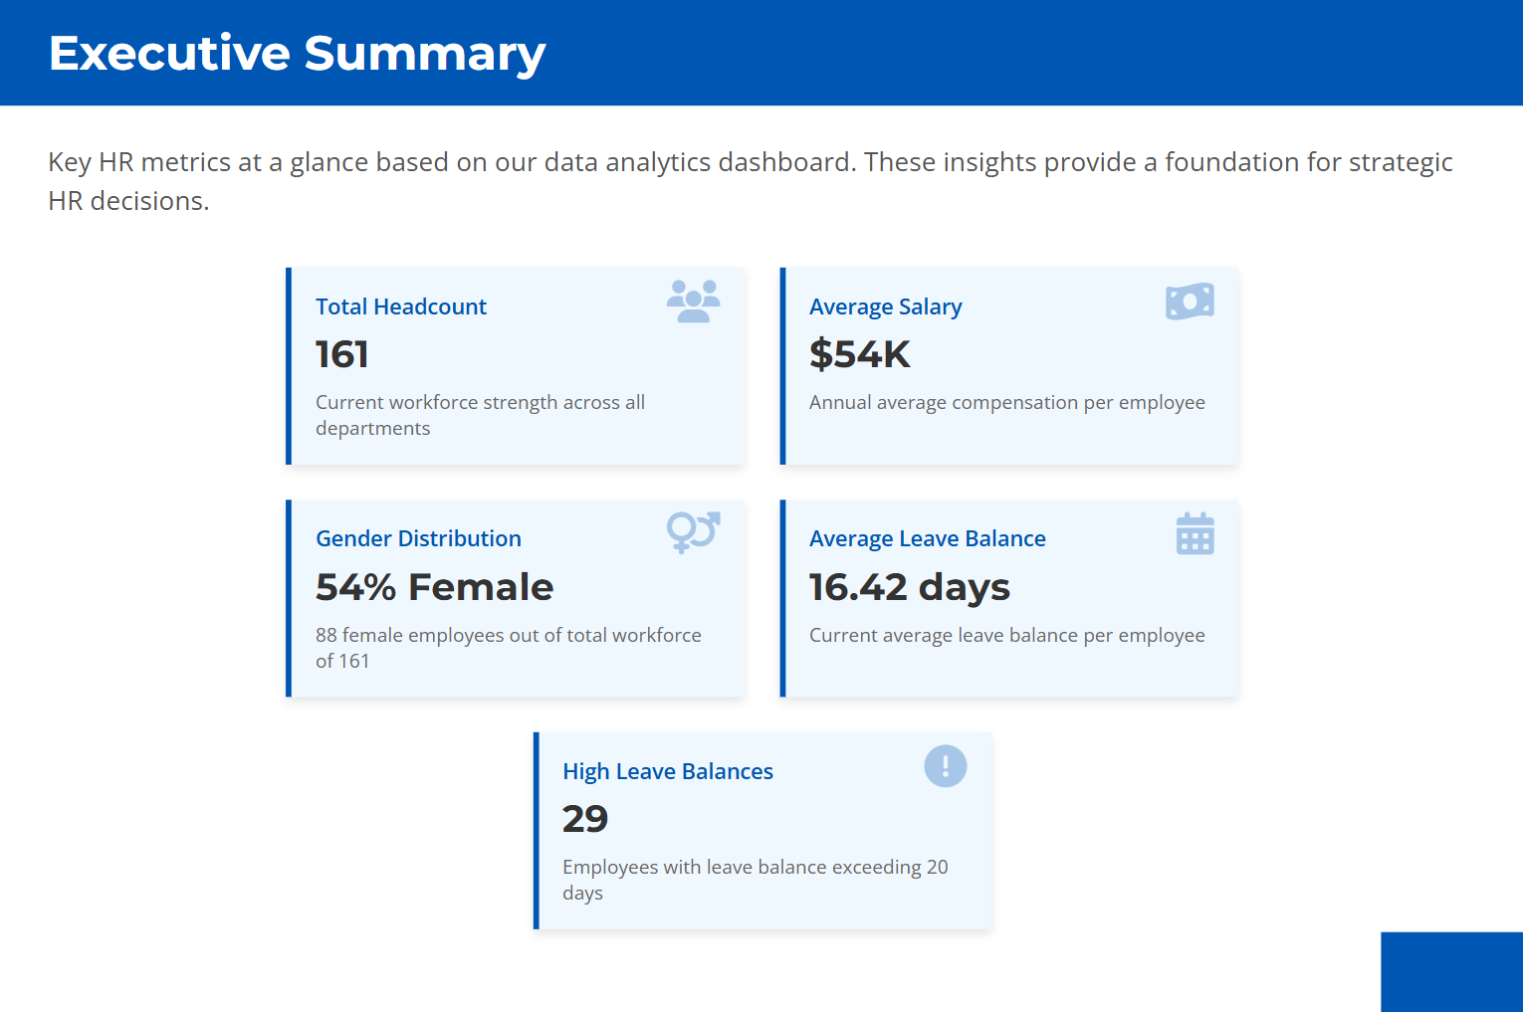

Slide 5
EXECUTIVE SUMMARY ANALYSIS
Core Components Analysis
KPI Presentation Strategy
This executive summary demonstrates optimal metric selection theory by focusing on five critical areas:
Workforce Capacity (Total Headcount: 161)
Compensation Analysis (Average Salary: $54K)
Diversity Metrics (Gender Distribution: 54% Female)
Operational Efficiency (Leave Balance: 16.42 days)
Risk Identification (High Leave Balances: 29 employees)
Visual Communication Theory
The dashboard applies cognitive load management principles by using clean visual hierarchy, strategic color coding, and intuitive iconography to enable rapid executive comprehension. This design philosophy ensures executives can quickly identify patterns and areas requiring attention.

Slide 6
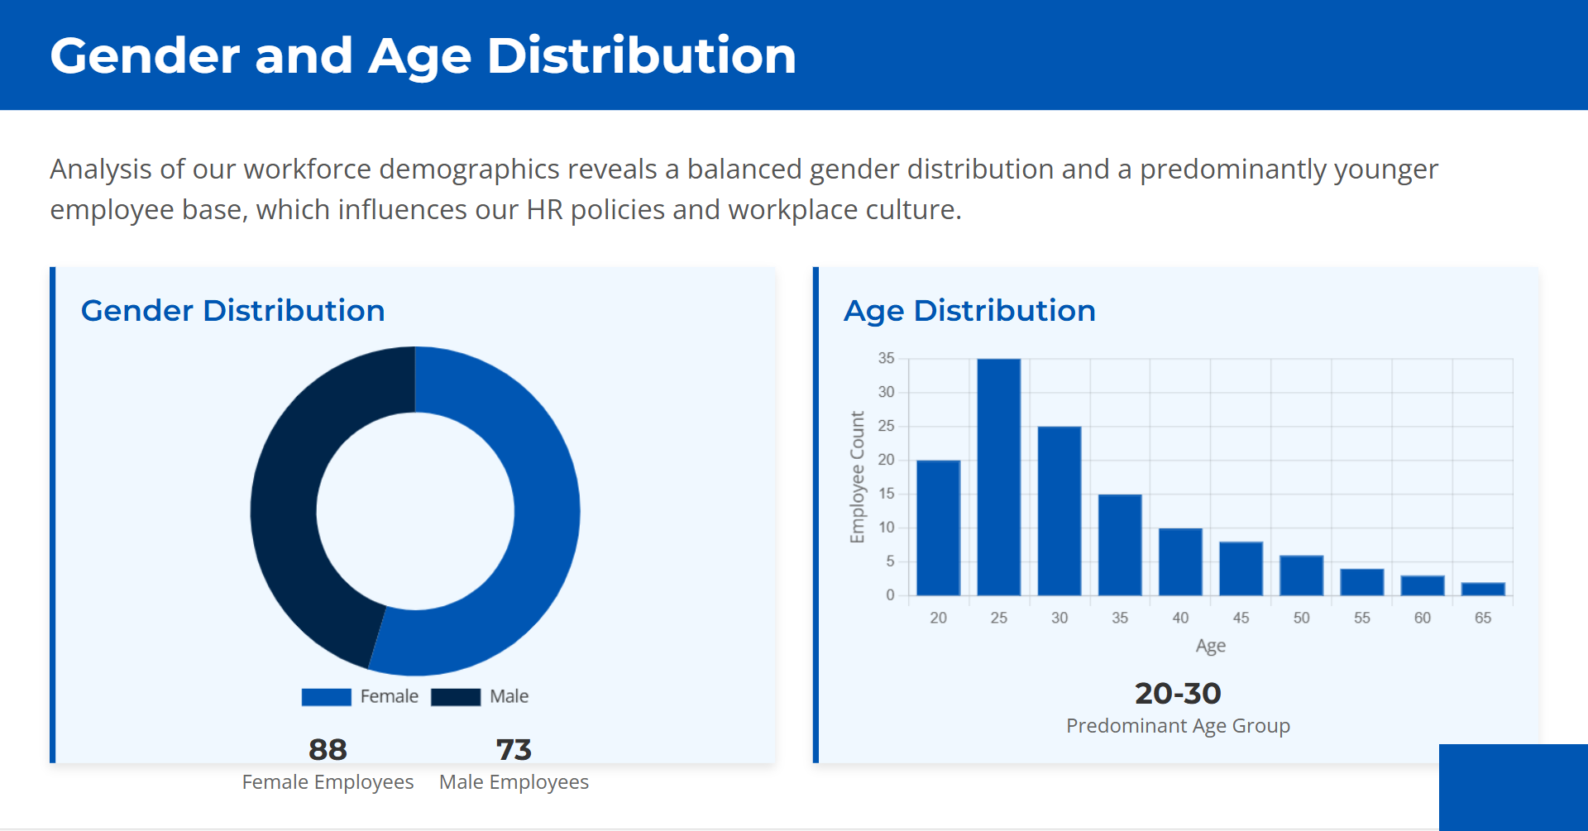

Slide 7
GENDER AND AGE ANALYSIS
Human Capital Theory Framework
The theoretical foundation establishes that age and gender distribution reflects accumulated organizational knowledge, skills, and experience. Your data showing 54% female and predominantly 20-30 age group creates unique strategic implications for knowledge management, innovation capacity, and succession planning requirements.
Diversity and Inclusion Theory
The balanced gender distribution in your organization aligns with diversity theory, which suggests heterogeneous demographic composition enhances performance through cognitive diversity, innovation enhancement, and competitive advantage. The 88:73 female-to-male ratio demonstrates optimal gender balance for organizational effectiveness.

Slide 8
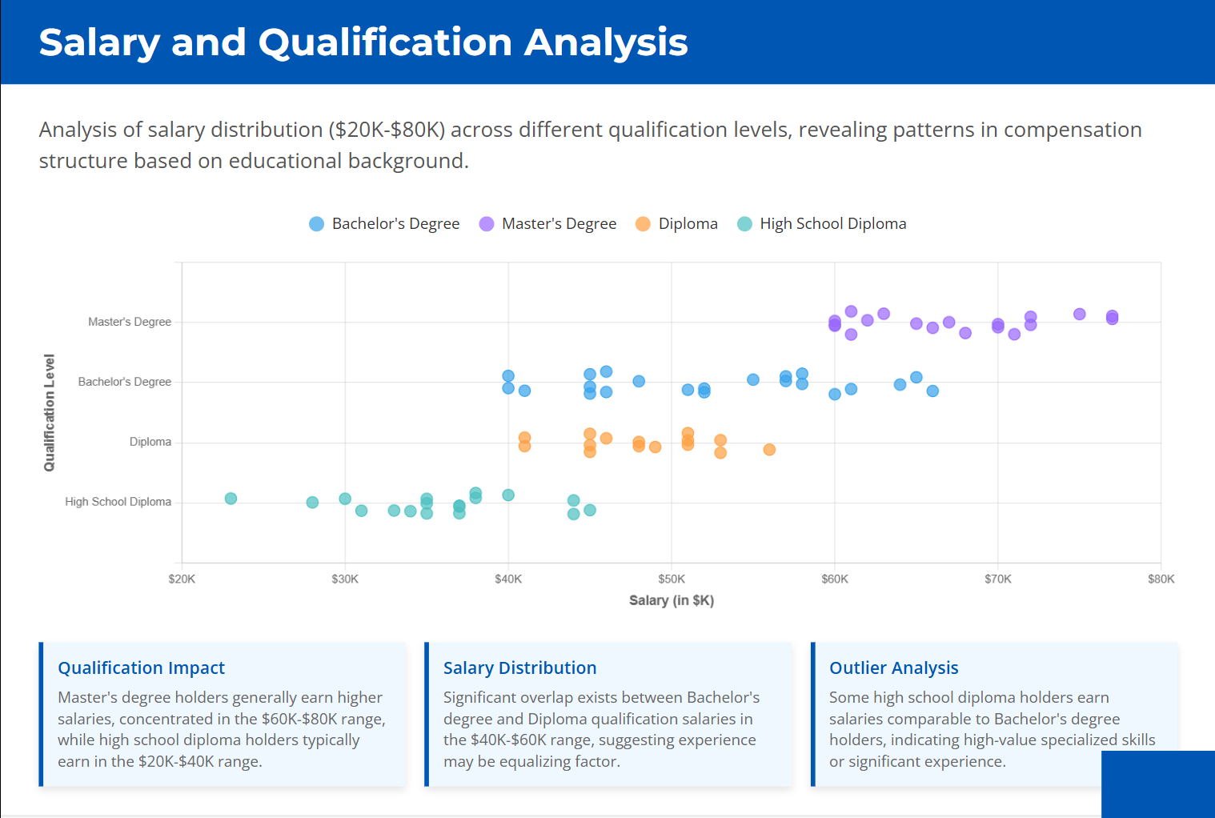

Slide 9
SALARY AND QUALIFICATION ANALYSIS
Elasticity Principle- Salary increases are not linear with qualification; they depend on industry, role, and skill relevance.
Threshold Effect- Master's degree holders often cross the $60K threshold due to advanced roles and leadership potential.
Outlier Dynamics- High school diploma holders earning >$50K often possess niche skills (e.g., trades, sales, or tech certifications).
Market Modifier- External factors like geography, company size, and sector (tech vs. manufacturing) influence salary bands.

Slide 10
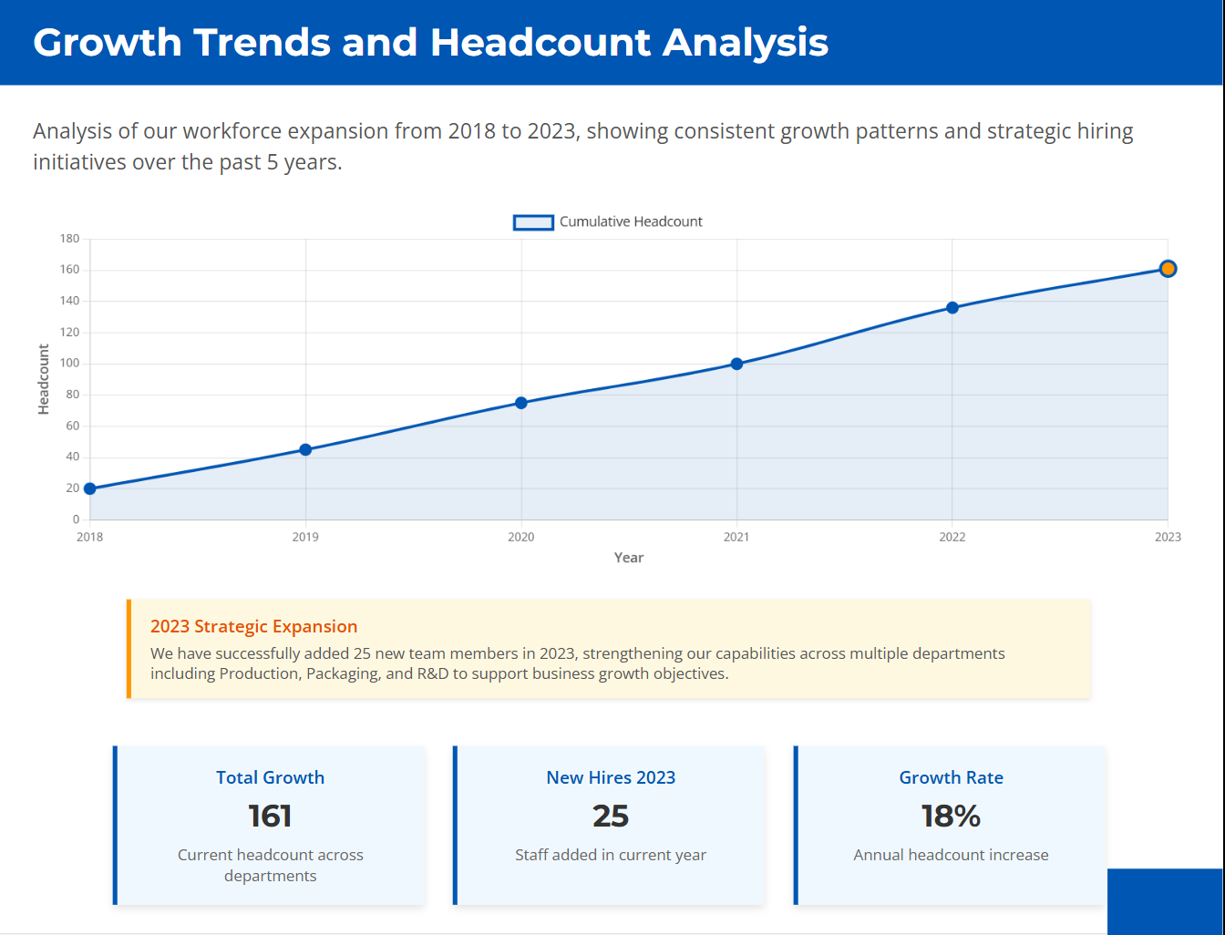

Slide 11
Growth and Headcount Analysis
Growth continuity- A consistent upward trend in headcount from 2018–2023 signals stable business expansion.
Departmental Diversification- Hiring across Production, Packaging, and R&D shows balanced investment in core and innovation functions.
Annual Growth Rate Benchmark- An 18% annual increase is a strong indicator of proactive talent acquisition aligned with business goals.
Strategic Year Focus- The 2023 spike (25 new hires) suggests a targeted push—possibly due to new product lines or market entry.
Cumulative Strength Metric- 161 total headcount reflects organizational maturity and capacity to handle scale.

Slide 12
